Slide 1


x
PARTNERSHIP
Not Into Finance x ICMSS UI
2026
Confidential & Proprietary © 2026 Not Into Finance & Indonesia Capital Market Student Studies. All rights reserved.

Slide 2


Introduction to
Not Into Finance
Not Into Finance (NIFI) is a research, education, and community platform that makes finance and investing easier to understand for people across different experience levels. Through research publications, educational content, classes, and community activities, NIFI connects financial analysis with practical learning for students, retail investors, professionals, and beginners.
NIFI delivers its mission through three core pillars:
01
Research: We translate company, industry, macroeconomic, and market analysis into accessible insights, helping our audience understand the drivers behind businesses, financial markets, and investment opportunities.
02
Education: We make financial knowledge accessible through educational content and classes, covering investing fundamentals, risk, valuation, and equity research to help people build their understanding and make informed decisions.
03
Community: We bring people together through Discord discussions, classes, meetups, and #NiFiBerbagi activities, creating an inclusive space for shared learning, meaningful connections, and community participation.
Confidential & Proprietary © 2026 Not Into Finance. All rights reserved.

Slide 3
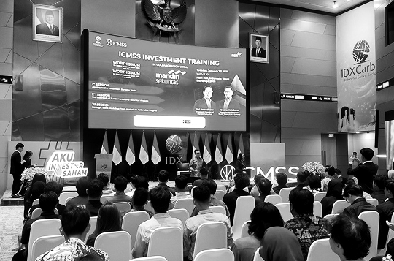
Introduction to Indonesia Capital Market Student Studies (ICMSS)
Indonesia Capital Market Student Studies (ICMSS) is an annual capital market event organized by the Management Student Society at the Faculty of Economics and Business, Universitas Indonesia. Through research competitions, seminars, and investment training, ICMSS helps students and the wider public understand financial markets, develop analytical skills, and learn from industry professionals.
ICMSS pursues its vision of becoming an international capital market learning center for students through three main programs:
01
Equity Research Conference: A competition where undergraduate students analyze publicly listed companies, develop equity research reports, and present investment recommendations to experienced equity analysts.
02
Capital Market Seminar: Seminars featuring industry professionals who share perspectives on economic developments, market trends, and the outlook for Indonesia’s capital markets.
03
Investment Training: Learning sessions that introduce participants to stock investing, providing foundational knowledge and practical tools to support informed investment decisions.
Confidential & Proprietary © 2026 Not Into Finance & Indonesia Capital Market Student Studies. All rights reserved.

Slide 4
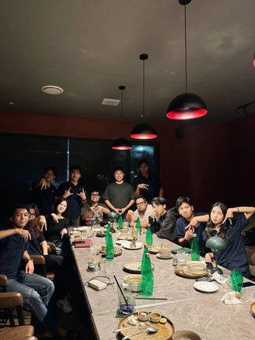
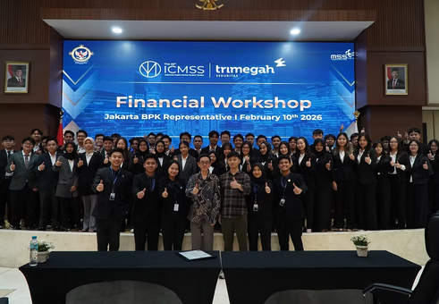
x
Why NIFI × ICMSS
A Shared Purpose
NIFI and ICMSS bring together research, education, and capital market competition experience to help aspiring equity researchers turn financial knowledge into practical analysis and informed investment recommendations.
Complementary Strengths
NIFI brings accessible research, practical finance education, and community engagement. ICMSS brings experience in equity research competitions, investment training, and capital market seminars. Together, these strengths support a learning journey from understanding companies to presenting investment ideas.
What This Collaboration Brings
Three strengths supporting the participant journey:
01
Research into Practice: Connect research insights with company analysis and valuation, helping participants develop investment recommendations supported by evidence.
02
Structured Learning: Build equity research skills through classes, assignments, and report writing within a clear learning journey.
03
Investment Pitching: Apply research through presentations, helping participants communicate their investment thesis, valuation, and risks clearly.
Confidential & Proprietary © 2026 Not Into Finance & Indonesia Capital Market Student Studies. All rights reserved.

Slide 5





x
Program Overview
NIFI x ICMSS Equity Research Bootcamp
An online bootcamp designed to help participants develop practical equity research skills through structured learning, assignments, and investment pitching.
Learning Session
Program Format
Planned Schedule
Registration Fee
Final Stage
8
Online Learning
Late November 2026
Rp200.000
Top 10 Finalist
Learning Journey & Participant Outcomes
From Financial Knowledge to Investment Recommendations
A Structured Journey from foundational learning to research application and investment Pitching
Foundation Classes
Equity Research Training
Assessment Process
Finalist Pitching
Build a foundation in capital markets and equity research.
Develop skills in company analysis, financial modeling, and research writing.
Apply learning through assignments and equity research reports.
The top 10 finalists present their research and investment recommendations to judges via Discord.
Participant Benefit
Equity Research Learning Materials
Professional Training Exposure
Acces to International Competition
Winner Opportunity: WPPE / WMI Training
Bloomberg Company Visit
Arthara Subscription Access
Structured Modules and real case studies.
Learn from industry experts & practitioners.
Free access for winner to attend ERC by ICMSS
For winners; subject to partner terms
Gain first-hand exposure to the financial industry and a professional working environment through a visit to Bloomberg.
Gain access to premium research platform
Confidential & Proprietary © 2026 Not Into Finance & Indonesia Capital Market Student Studies. All rights reserved.

Slide 6
x
Program Overview
NIFI x ICMSS Equity Research Bootcamp
An online bootcamp designed to help participants develop practical equity research skills through structured learning, assignments, and investment pitching.
Learning Session
Program Format
Planned Schedule
Registration Fee
Final Stage
8
Online Learning
Late November 2026
Rp200.000
Top 10 Finalist
Learning Journey & Participant Outcomes
From Financial Knowledge to Investment Recommendations
A Structured Journey from foundational learning to research application and investment Pitching
Foundation Classes
Equity Research Training
Assessment Process
Finalist Pitching
Build a foundation in capital markets and equity research.
Develop skills in company analysis, financial modeling, and research writing.
Apply learning through assignments and equity research reports.
The top 10 finalists present their research and investment recommendations to judges via Discord.
Participant Benefit
Equity Research Learning Materials
Professional Training Exposure
Acces to International Competition
Winner Opportunity: WPPE / WMI Training
Bloomberg Company Visit
Arthara Subscription Access
Structured Modules and real case studies.
Learn from industry experts & practitioners.
Free access for winner to attend ERC by ICMSS
For winners; subject to partner terms
Gain first-hand exposure to the financial industry and a professional working environment through a visit to Bloomberg.
Gain access to premium research platform
Confidential & Proprietary © 2026 Not Into Finance & Indonesia Capital Market Student Studies. All rights reserved.

Slide 7
x
Program Timeline
2 November
25 November
27 November
Registration
Participant On Boarding
Bootcamp Session
TBD
TBA
TBA
Final Pitching & Awards
Assessment & Finalist Announcement
Research Submission
Session 1
Session 2-3
Session 4-5
Session 6-7
Session 8
Equity Research Foundations
Business & Financial Statements
Analysis & Forecasting
Valuation, Risk, & ESG
Research Writing & Pitching
Introduction to Equity Research:
Ratings, report structure and analyst ethics.
02 Business & Industry
04 Financial Analysis
06 Relative Valuation
Writing the Call and Defending It
Investment thesis, recommendation and a three-minute practice pitch.
Revenue drivers and competitive position.
Ratios, earnings quality and red flags.
Comps, multiples and target price.
03 Financial Statements
05 Forecasting
07 Intrinsic Valuation
Rebuild comparable historical financials.
Five-year projections and scenarios.
DCF, WACC, risks and ESG.
Understand the analyst’s role and research process.
Read the business and establish the financial baseline.
Translate business drivers into financial projections.
Assess value and the assumptions behind it.
Communicate and defend an investment recommendation.
Session dates and final-stage deadlines TBA.
Confidential & Proprietary © 2026 Not Into Finance & Indonesia Capital Market Student Studies. All rights reserved.

Slide 8
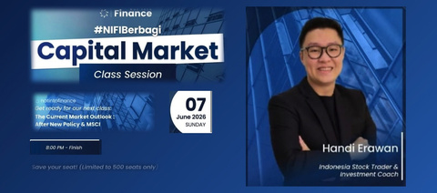
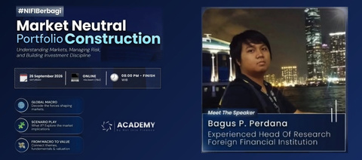
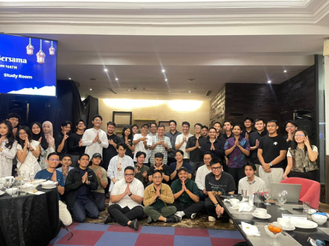
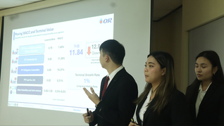
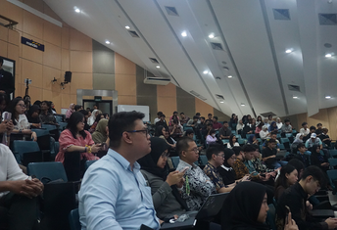
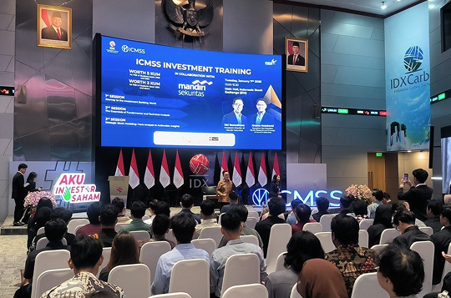




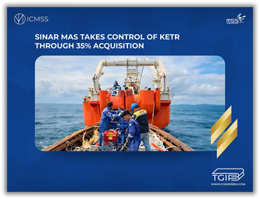
x
Our Track Record
Experience Across Research, Education & Community
NIFI and ICMSS bring experience in finance education, research, and community engagement—a relevant foundation for the joint equity research bootcamp.
Previous Activities
NIFI
Capital Market Class
NIFI Academy Bootcamp
Community Activities
ICMSS
Equity Research Conference
Capital Market Seminar
Investment Training
Previous Research
Confidential & Proprietary © 2026 Not Into Finance & Indonesia Capital Market Student Studies. All rights reserved.

Slide 9
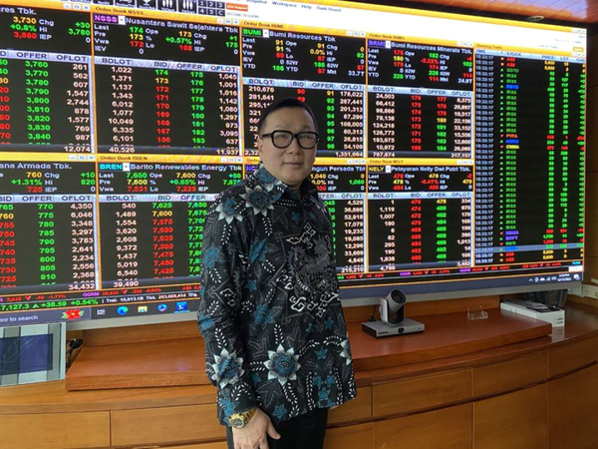

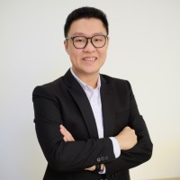
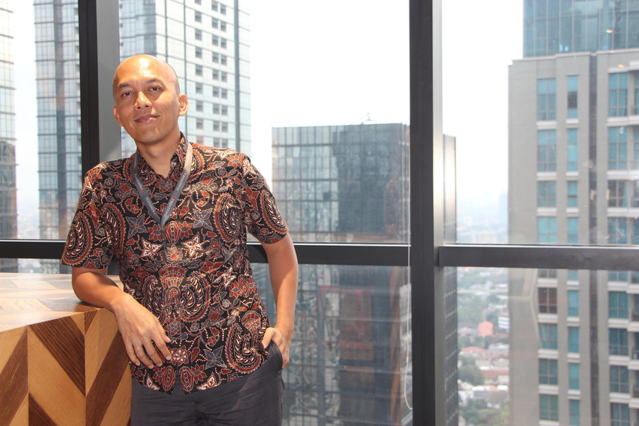

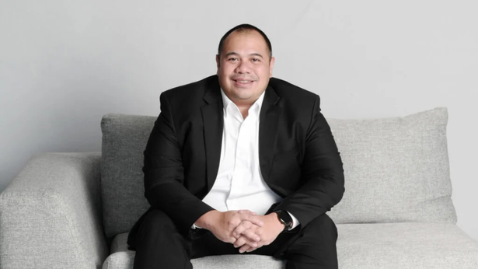
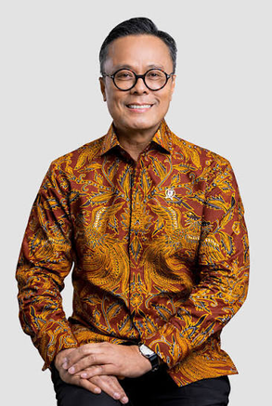
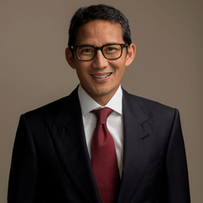
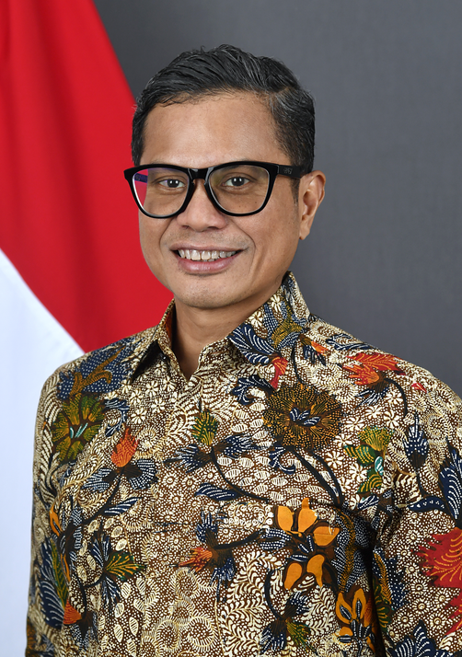
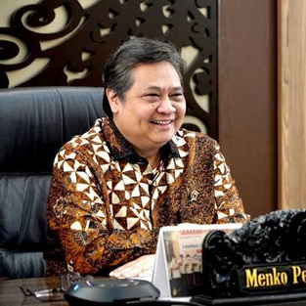
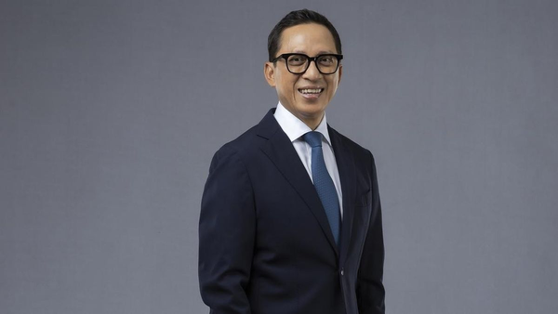
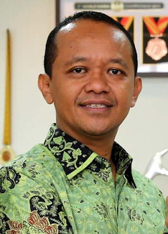
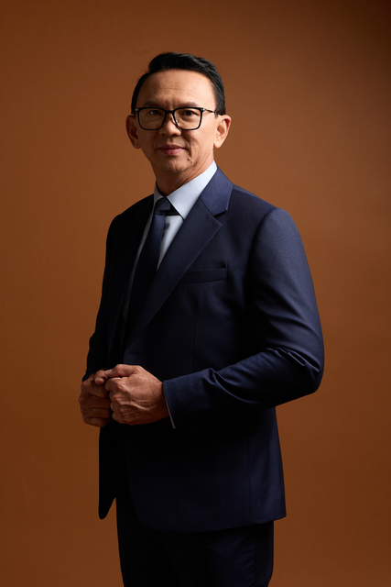
x
Industry Connections
Experience Across Research, Education & Community
NIFI and ICMSS bring experience in finance education, research, and community engagement—a relevant foundation for the joint equity research bootcamp.
Selected Previous Speakers
Not Into Finance
Key Note Speker NIFI Academy
Key Note Speker NIFI Academy
Speaker #NIFIBERBAGI
Speaker #NIFIBERBAGI
Ahmad Solihin
Harry Su
Faza Verdana
Handi Erawan
Syailendra Capital
Samuel Sekuritas
Revalue Academy
House of Trader
Indonesia Capital Market Student Studies
Speaker Capital Market Seminar
Speaker Capital Market Seminar
Speaker Capital Market Seminar
Speaker Capital Market Seminar
Pandu Sjahrir
Dony Oskaria
Sandiaga Uno
Pahala Mansury
Danantara Indonesia
Danantara Indonesia
Indonesia’s Minister
CFA Society Indonesia
Speaker Capital Market Seminar
Speaker Capital Market Seminar
Speaker Capital Market Seminar
Speaker Capital Market Seminar
Airlangga Hartarto
Oki Ramadhana
Bahlil Lahadalia
Basuki T. Purnama
Indonesia’s Minister
Mandiri Sekuritas
Indonesia’s Minister
Indonesia’s Former Governor
Confidential & Proprietary © 2026 Not Into Finance & Indonesia Capital Market Student Studies. All rights reserved.

Slide 10


















x
Previous Partners
Not Into Finance
Indonesia Capital Market Student Studies
Confidential & Proprietary © 2026 Not Into Finance & Indonesia Capital Market Student Studies. All rights reserved.

Slide 11



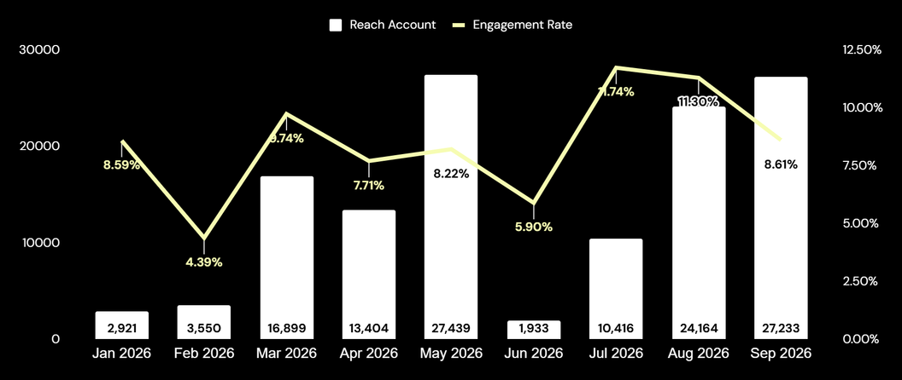
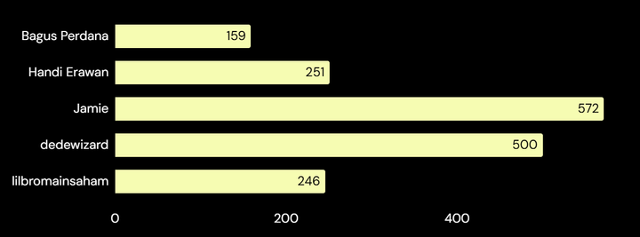
Audience & Engagement
NIFI Digital Reach & Learning Participation
Research content, educational programs, and community channels connect NIFI with people interested in finance & investing.
Followers
Followers
Member
4638
7100+
4800+
Reach Account
Avg. Engmnt. Rate
127,959
8.47%
Historical Participant Class
1706
Ticket Units
Ticket units represent historical sales, not unique participants or actual attendance.
Confidential & Proprietary © 2026 Not Into Finance & Indonesia Capital Market Student Studies. All rights reserved.

Slide 12




Event Scale & Impact
ICMSS Capital Market Events & Learning Programs
Indonesia's biggest and oldest student-run capital market event, uniting students, professionals, and industry leaders with support from IDX and CFA Society Indonesia.
Followers
X
Followers
Linkedin
Followers
7729
1696
955
Total Participants
Years Running
Speakers & Panelists
10,000+
25
160+
Flagship Programs at The 25th ICMSS
Capital Market Seminar
2-day, open to public
1,500+ audience
Investment Training
Hands-on training
245+ participants
Equity Research Conference
Local + foreign teams
60+ participants · 160+ audience
Also featuring Trading Competition & #BlueTalks digital talk show · run by 80+ committee members
Audience Profile
Age distribution · 90% aged 14–34
72%
72%
18%
5%
5%
14–25 (Gen Z)
25–34
Gen Z audience
(aged 14–25)
35–44
45+
2,500+ students of Universitas Indonesia
Program and audience figures are based on The 25th ICMSS. Total participants and speakers & panelists are cumulative across past editions.
Confidential & Proprietary © 2026 Not Into Finance & Indonesia Capital Market Student Studies. All rights reserved.

Slide 13
x
Talent Partnership
Not Into Finance x ICMSS UI
2026
Confidential & Proprietary © 2026 Not Into Finance & Indonesia Capital Market Student Studies. All rights reserved.

Slide 14
x
Talent Partnership Opportunity
Connect Emerging Research Talent with Industry Opportunities
Partner with NIFI × ICMSS to offer the top three bootcamp winners a direct internship interview opportunity.
The Talent Profile
Company Analysis
Financial Modelling & Valuation
Research Writing & Pitching
Understanding businesses and industry dynamics.
Building forecasts and assessing company value.
Communicating an investment recommendation.
Partner Contribution
Partner Benefits
Interview Opportunity
Access to Emerging Talent
Offer the top three winners a direct internship interview opportunity.
Meet shortlisted candidates with equity research work samples.
Eligibility Requirements
Talent Partner Recognition
Share relevant internship roles, requirements, and selection criteria.
Receive logo placement on agreed program materials.
Recruitment Coordination
Dedicated Partnership Post
Appoint a contact to coordinate candidate submissions and interviews.
Introduce the partnership through one dedicated social media post.
Help turn research potential into professional opportunity.
Confidential & Proprietary © 2026 Not Into Finance & Indonesia Capital Market Student Studies. All rights reserved.

Slide 15
x
Talent Selection & Recruitment Process
From Bootcamp Performance to Recruitment Consideration
A coordinated process connects selected winners with the partner’s internship recruitment team.
Winner Selection
Candidate Submission
NIFI × ICMSS identifies the top three winners through the bootcamp assessment and final pitching process.
With each candidate’s consent, the organizers share their profile and available research work samples.
Partner Interview
Hiring Decision
The partner conducts interviews based on the agreed internship requirements and eligibility criteria.
The partner determines internship offers through its own recruitment process.
Candidate Portfolio
Curriculum Vitae
Equity Research Report
Financial Model
Pitch Deck
Candidate background, experience, and relevant skills.
Company analysis, valuation, investment thesis, and risks.
Historical financial analysis, forecasts, and valuation workings.
A concise presentation of the investment recommendation.
Interview access does not guarantee an internship offer. Candidate eligibility and recruitment arrangements will be agreed with the partner.
Confidential & Proprietary © 2026 Not Into Finance & Indonesia Capital Market Student Studies. All rights reserved.

Slide 16
x
Case Collaborator
Not Into Finance x ICMSS UI
2026
Confidential & Proprietary © 2026 Not Into Finance & Indonesia Capital Market Student Studies. All rights reserved.

Slide 17
x
Case Collaboration Opportunity
Bring Your Business into the Research Classroom
Partner with NIFI × ICMSS to introduce your company as the shared equity research case for participant assessment and final pitching.
One Listed Company. One Shared Research Case.
Company Contribution
Collaboration Benefits
Company Presentation
Case Collaborator Recognition
Deliver one session introducing the company’s business model, operating performance, and strategic priorities.
Receive recognition and logo placement on agreed case materials and final pitching publications.
Public Research Materials
Dedicated Announcement Post
Share publicly available reports, presentations, and other materials to support participant analysis.
Introduce the collaboration through one dedicated social media post.
Optional Judging Participation
Business Exposure
Nominate a company representative to join the final judging panel, subject to agreed assessment arrangements.
Present your company’s business and strategic priorities to aspiring equity researchers.
Connect business insights with independent research and practical learning.
Confidential & Proprietary © 2026 Not Into Finance & Indonesia Capital Market Student Studies. All rights reserved.

Slide 18
x
Case Development & Assessment Process
From Company Understanding to Investment Recommendations
Participants research the same company throughout the assessment and final pitching stages.
Company Briefing
Research Development & Submission
The company introduces its business, operating performance, and strategic priorities through one presentation supported by public materials.
Participants analyze the company and submit their research report, supported by financial forecasts and valuation analysis.
Finalist Selection
Final Pitching
Submissions are assessed using a consistent rubric to select the top ten finalists.
Finalists present and defend their investment recommendations before the judging panel.
Participant Research Outputs
Business & Industry Analysis
Financial Analysis & Forecasting
Valuation & Recommendation
Investment Risks & ESG
Business model, revenue drivers, industry dynamics, and competitive position.
Historical performance, earnings quality, operating assumptions, and financial projections.
Valuation methods, target price, investment thesis, and supporting evidence.
Key risks, scenario implications, and material ESG considerations.
Assessment Principles
Research quality, supporting evidence, analytical consistency, and clarity of presentation.
Research Independence
Company input may clarify factual information. Investment recommendations remain the participants’ independent conclusions.
Confidential & Proprietary © 2026 Not Into Finance & Indonesia Capital Market Student Studies. All rights reserved.

Slide 19
x
Media & Community Partnership
Not Into Finance x ICMSS UI
2026
Confidential & Proprietary © 2026 Not Into Finance & Indonesia Capital Market Student Studies. All rights reserved.

Slide 20
x
Community Partnership Referral Program
Give your community a registration discount and earn a commission for every valid paid registration through your referral code.
Standard registration fee: IDR 200,000
Participant Discount
Partner Commision
Participant Payment
Rp15.000
Rp15.000
Rp185.000
Participant Price
Rp200.000 - Rp15.000 = Rp185.000
How It Works?
Share Your Code
Register & Pay
Earn Commission
Distribute your unique referral code to your community.
Participants enter the code and complete payment.
Receive IDR 15,000 for each verified eligible registration.
Illustrative Example
10 Valid Paid Registrations
10 × Rp15,000 = Rp150,000
Partner commission
Commission applies to valid paid registrations that have not been refunded.
Confidential & Proprietary © 2026 Not Into Finance & Indonesia Capital Market Student Studies. All rights reserved.

Slide 21
x
Media Partnership
Publication Exchange
Support the bootcamp through reciprocal publication across agreed social media and community channels.
Choose Media Partnership, Community Partnership, or Both.
Partner Deliverables
Organizer Deliverables
Instagram Stories
Promotional Materials
Publish bootcamp announcements and registration reminders through agreed Instagram Stories.
Provide ready-to-post visuals, captions, and registration links.
Community Distribution
Community Distribution
Share promotional materials in agreed community groups.
Include the partner’s logo on agreed program publications.
Publication Schedule
Reciprocal Publication
Publish according to the agreed content plan and schedule.
Publish agreed partner content through selected organizer channels.
Publication Plan
Story quantities, group posts, reposts, channels, and dates will be agreed before activation.
Custom Media Partnership
Have a different collaboration in mind? We’re open to discussing a custom publication exchange tailored to your channels, content formats, deliverables, and schedule.
Contact our partnership team to explore a suitable arrangement.
Confidential & Proprietary © 2026 Not Into Finance & Indonesia Capital Market Student Studies. All rights reserved.

Slide 22
x
Publication & Referral Mechanics
Clear Deliverables. Clear Tracking.
Partners may participate in publication exchange, the referral program, or both.
Publication Process
Referral Process
Agree the Plan
Receive Your Code
Confirm channels, publication quantities, and dates.
Organizers assign one unique referral code per partner.
Receive Materials
Record Registrations
Organizers provide approved visuals, captions, and links.
Participants enter the code when registering.
Publish Content
Validate Payments
Partner and organizer publish their agreed deliverables.
Organizers verify paid registrations and refund status.
Confirm Delivery
Report & Pay
Share publication links or screenshots for the activity recap.
Partner receives a registration recap and commission according to the agreed payout schedule.
Referral Terms
One referral code per registration.
Referral discounts cannot be combined with other promotions unless agreed.
Commission applies to valid paid, non-refunded registrations.
Publication dates, referral period, and payout schedule will be agreed before activation.
Confidential & Proprietary © 2026 Not Into Finance & Indonesia Capital Market Student Studies. All rights reserved.

Slide 23
x
The Sponsorship
Package
Partnering with Not Into Finance x ICMSS means supporting talent development through hands-on learning, guided mentorship, and exposure to real industry expectations. Your contribution helps create an environment where young learners build practical skills and the confidence to apply them.
Our sponsorship options offer brand visibility, participant engagement, and long-term impact. By joining us, your organization is recognized as a collaborative partner in shaping future talent and strengthening the connection between education and industry.
Benefits | Media Partner (to be negotiated) | Gold Package (to be negotiated) | Main Sponsor (to be negotiated)
Ad-libs by mc | ✓ | ✓ | ✓
Social Media Feeds (Instagram and TikTok) | ✓ | ✓ | ✓
Zoom background | M | L | XL
Poster/pamflet | M | L | XL
Booklet | M | L | XL
Certificate | M | L | XL
Naming Rights (Event x ...) | X | X | ✓
Add-on package | X | X | ✓
All sponsorship payments must be fully settled within 10 (ten) working days after the confirmation of collaboration, unless otherwise agreed in writing.
Confidential & Proprietary © 2026 Not Into Finance & Indonesia Capital Market Student Studies. All rights reserved.

Slide 24
x
Logo Placement
Twibbon
Booklet
Poster
XL
L
M
XL
L
M
XL
L
M
Virtual BG
Bumper
XL
L
M
XL
L
M
Certificate
XL
L
M
Confidential & Proprietary © 2026 Not Into Finance & Indonesia Capital Market Student Studies. All rights reserved.

Slide 25

x
Together, we turn potential into progress and learning into lasting impact.
Contact Person:
+62 812 9636 5009 - Thymoty
+62 878 8588 8879 - Kyna
in
notintofinance

